Slide 1
20111026_translator_comparison

Slide 2
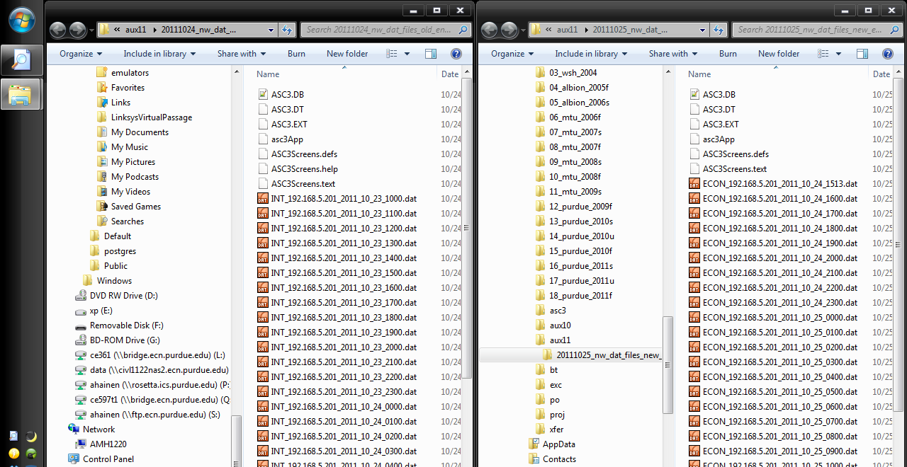
This is a comparison of the old (left) vs. new (right) filename for the dat files.
OLD : INT_IPX.XXX.XXX.XXX_YYYY_MM_DD_HHMM.dat
NEW : ECON_IPX.XXX.XXX.XXX_YYYY_MM_DD_HHMM.dat
OLD Dat Files
NEW Dat Files

Slide 3
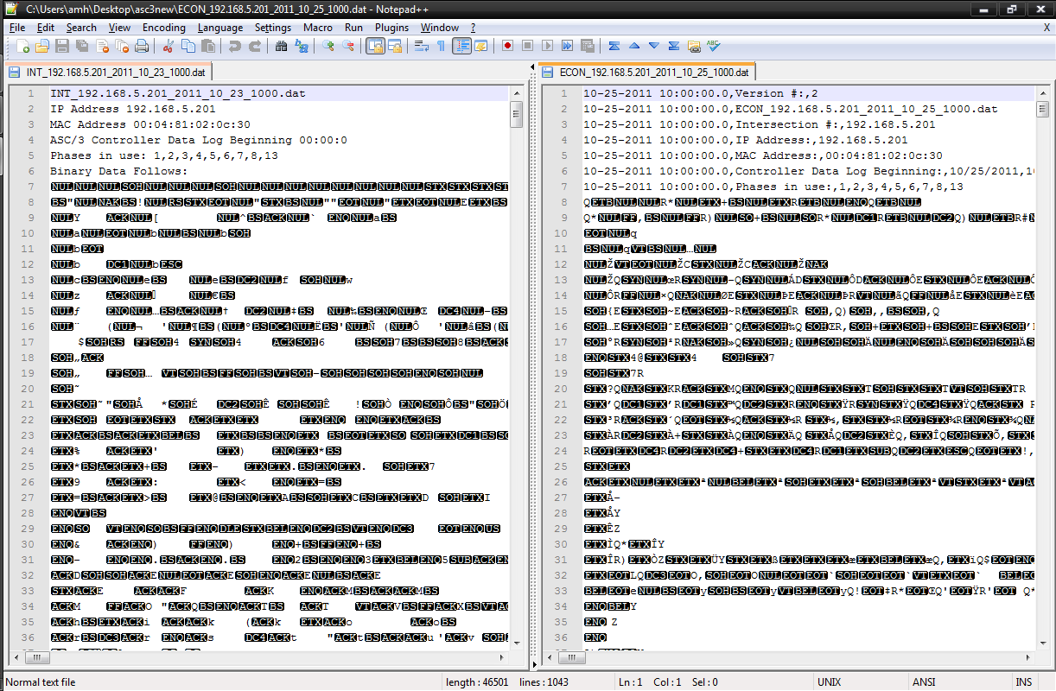
Note the extra initial row for version # in the header for the new file (right)
OLD Dat File
NEW Dat File

Slide 4
The new translator won’t work for old dat files.
Translator | OLD Dat File | NEW Dat File
Old | Yes
New (Win) | No
New (Linux)
NEW
Translator
OLD
Dat File

Slide 5
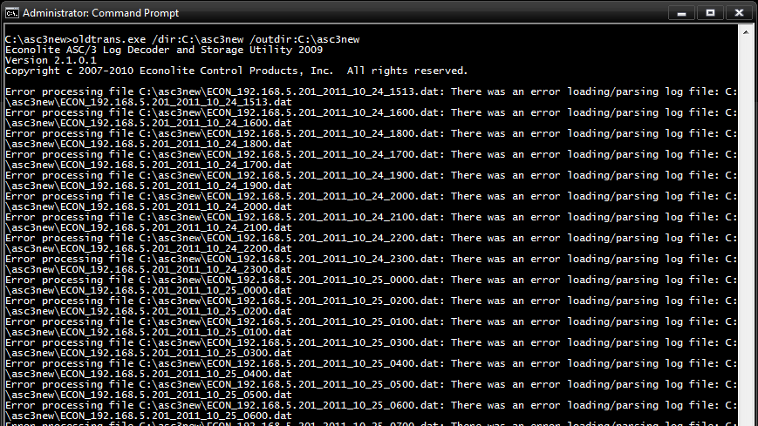
The old translator won’t work for new dat files.
Translator | OLD Dat File | NEW Dat File
Old | Yes | No
New (Win) | No
New (Linux)

Slide 6
The new translator works for new dat files.
Note the new format for multiple files.
Translator | OLD Dat File | NEW Dat File
Old | Yes | No
New (Win) | No | Yes
New (Linux)
NEW
Translator
NEW
Dat File
NEW
Dat File

Slide 7
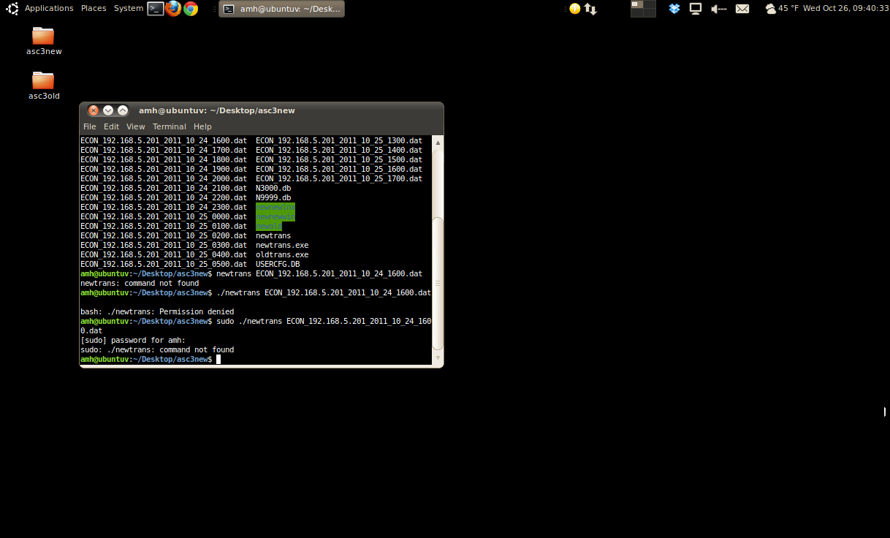
Not sure why newtrans won’t work in Linux.
Translator | OLD Dat File | NEW Dat File
Old | Yes | No
New (Win) | No | Yes
New (Linux) |  | ???

Slide 8
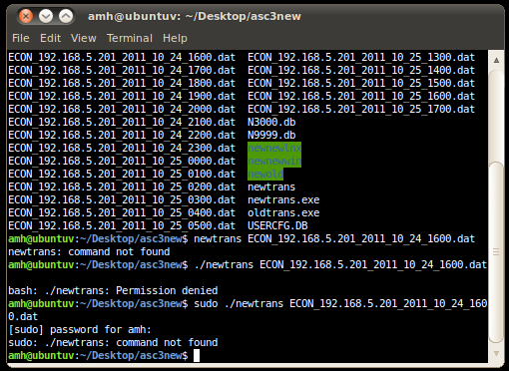
Not sure why newtrans won’t work in Linux.
Translator | OLD Dat File | NEW Dat File
Old | Yes | No
New (Win) | No | Yes
New (Linux) |  | ???

Slide 9
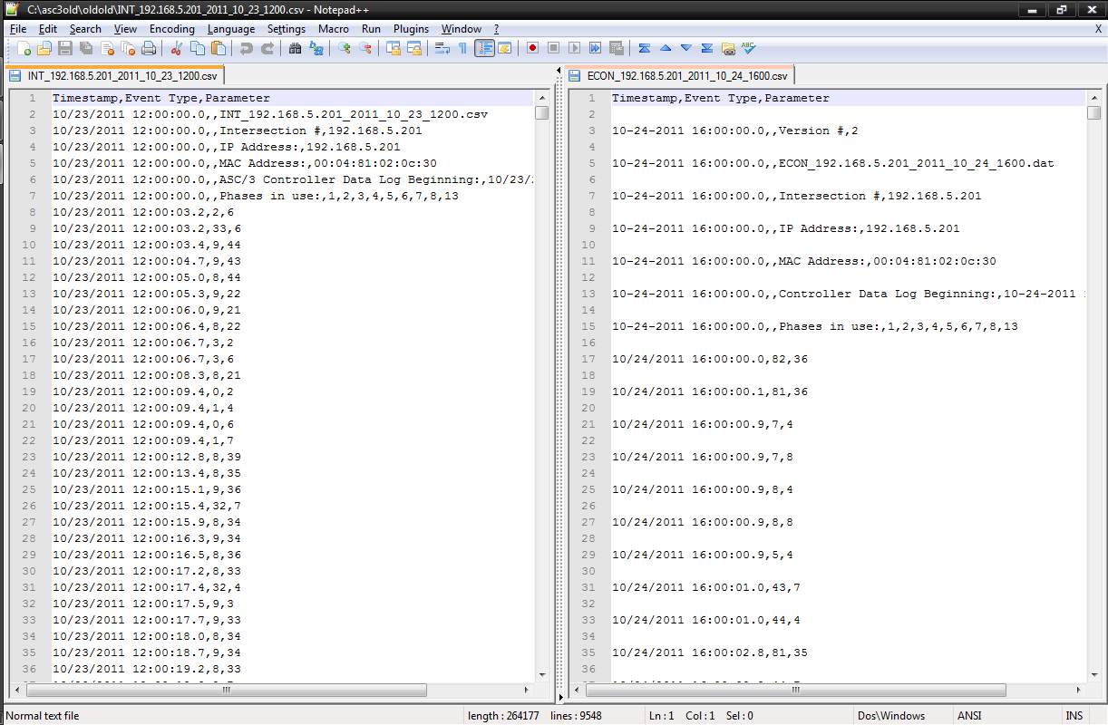
For the translator output, note the extra line.
OLD CSV File
NEW CSV File

Slide 11
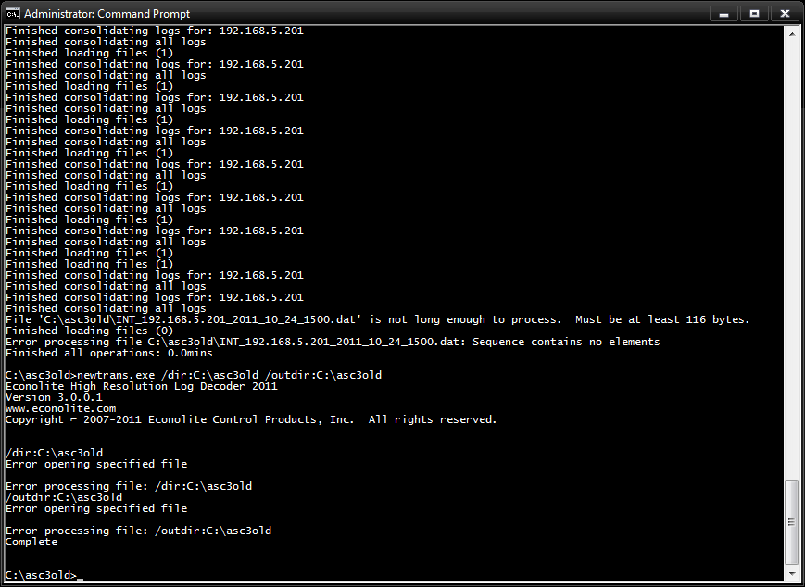
Note: The new translator might not do entire directories…will need to do loop for *.dat.

